Slide 1
Thermo-Mechanics
NE 591

Slide 2
Last Time
Solid mechanics predicts the deformation of a body from its applied load
The strain defines the deformation
The stress defines the material’s internal response to the strain
Materials can have recoverable and permanent deformation
Elastic deformation is recoverable and occurs due to the stretching of the atomic lattice
Plastic deformation is permanent and results form the breaking of bonds during dislocation (line defect) migration
We derived two analytical solutions for the stress in a pressurized cylinder
Thin walled cylinder
Any size wall

Slide 3
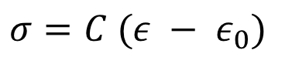
Thermal Expansion
As the temperature increases, atoms have larger vibrations, causing the material to expand
This expansion doesn’t raise the energy of the material when unrestrained
This expansion can be treated as a strain, but as one that doesn’t cause stress
$σ=C (ε − ε_{0})$

Slide 4
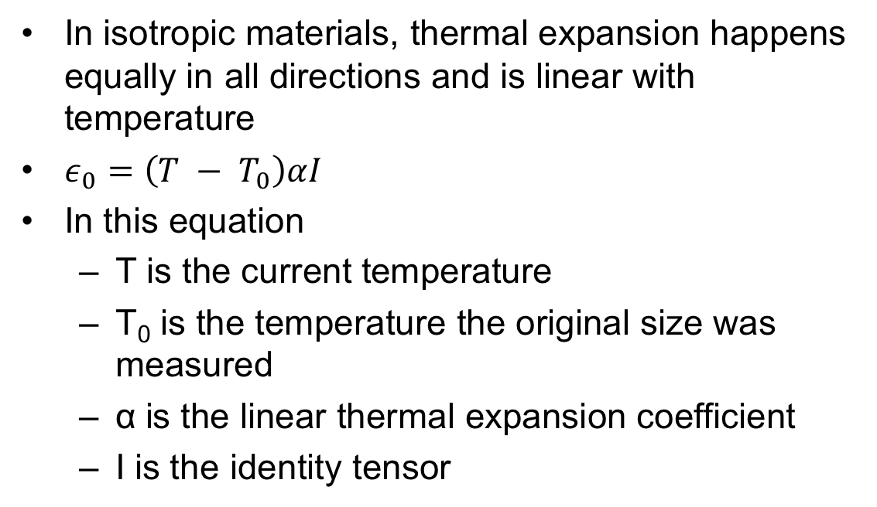
Thermal Expansion
In isotropic materials, thermal expansion happens equally in all directions and is linear with temperature
$ε_{0}=\left(T − T_{0}\right)αI$
In this equation
T is the current temperature
T₀ is the temperature the original size was measured
α is the linear thermal expansion coefficient
I is the identity tensor

Slide 5
Thermal Expansion
Though thermal expansion doesn’t directly cause stress, it can still lead to thermal stress

Slide 6
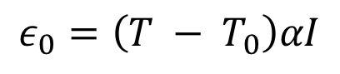
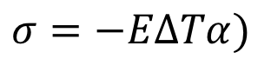
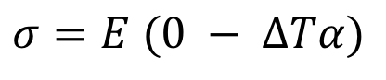
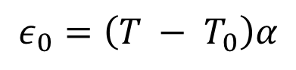
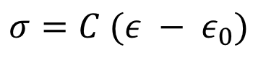
What is the stress in a thin constrained rod of length L when it is heated to ΔT?
The rod has a Young’s modulus of E and an expansion coefficient of α
$$ε_{0}=\left(T − T_{0}\right)αI$$
$σ=C (ε − ε_{0})$
$$ε_{0}=\left(T − T_{0}\right)α$$
$σ=E (0 − ΔTα)$
$σ=−EΔTα)$

Slide 7
The large temperature gradient within a fuel pellet results in large thermal stresses

Slide 8
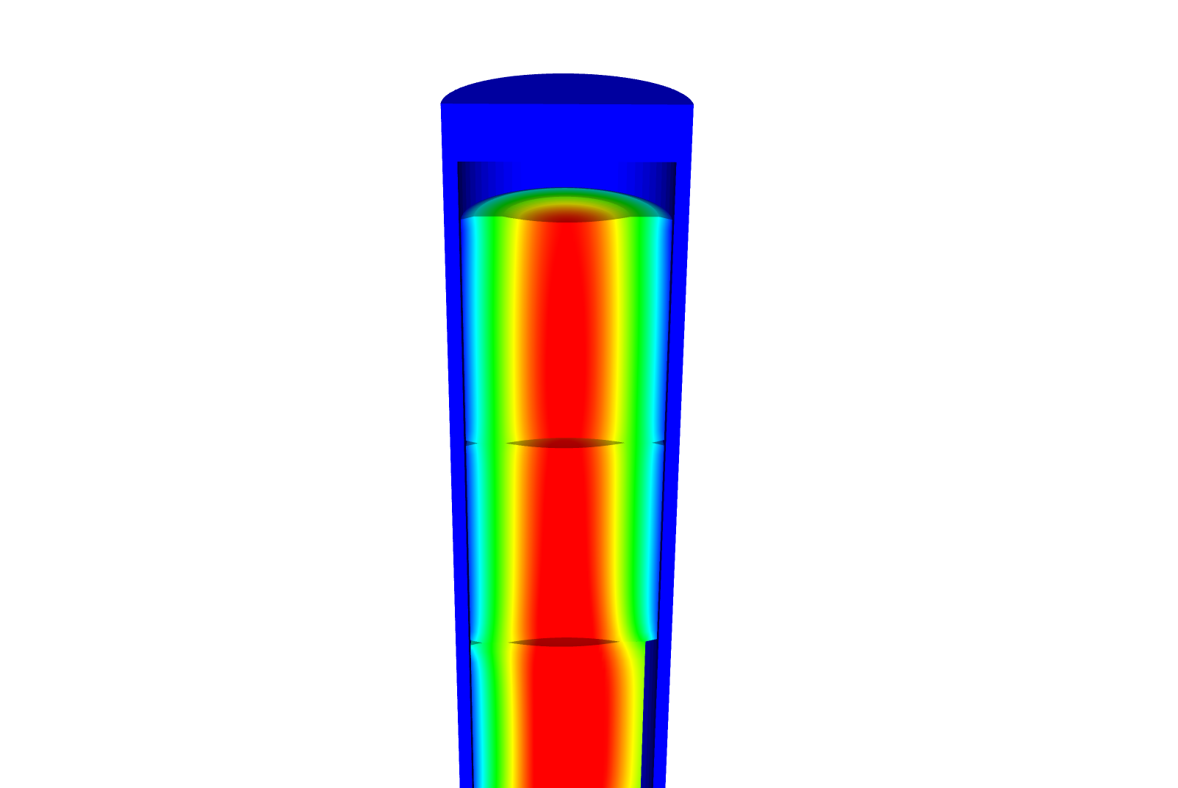
Consider the material response of the axisymmetric body
We assume small strains, so the strain is defined as
We assume isotropic material response, so

Slide 9
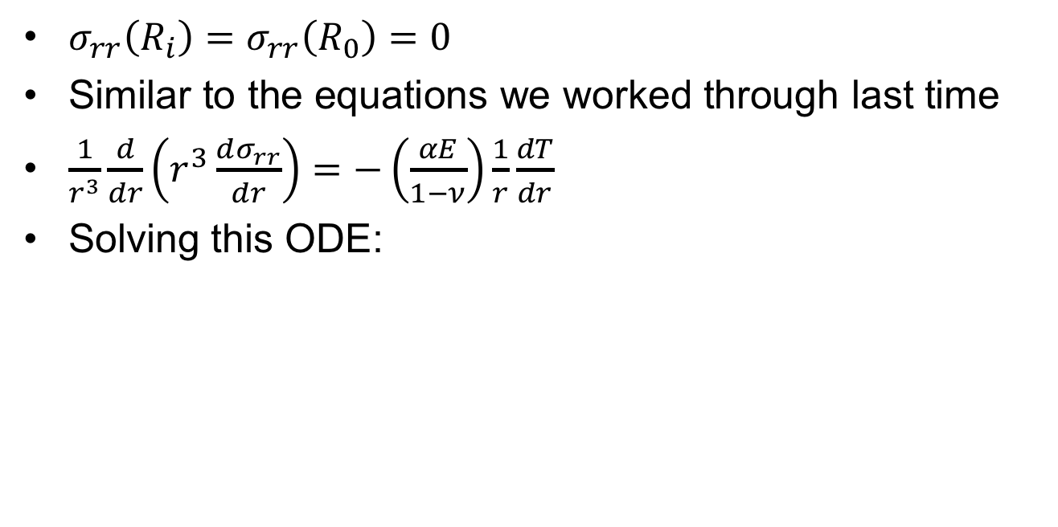
Consider a cylinder with thermal expansion but not pressure
$σ_{rr}\left(R_{i}\right)=σ_{rr}\left(R_{0}\right)=0$
Similar to the equations we worked through last time
$\frac{1}{r^{3}}\frac{d}{dr}\left(r^{3}\frac{dσ_{rr}}{dr}\right)=−\left(\frac{αE}{1−ν}\right)\frac{1}{r}\frac{dT}{dr}$
Solving this ODE:

Slide 10
What is the hoop stress in the cladding?

Slide 11
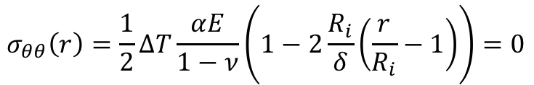
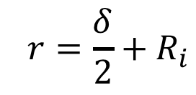
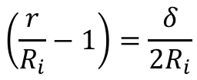
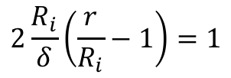
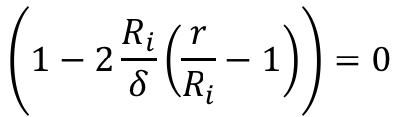
Where is hoop stress equal to zero?
$$σ_{θθ}\left(r\right)=\frac{1}{2}ΔT\frac{αE}{1−ν}\left(1−2\frac{R_{i}}{δ}\left(\frac{r}{R_{i}}−1\right)\right)=0$$
$$\left(1−2\frac{R_{i}}{δ}\left(\frac{r}{R_{i}}−1\right)\right)=0$$
$$\left.2\frac{R_{i}}{δ}\left(\frac{r}{R_{i}}−1\right)\right.=1$$
$$\left.\left(\frac{r}{R_{i}}−1\right)\right.=\frac{δ}{{2R}_{i}}$$
$$\left. r\right.=\frac{δ}{2}+R_{i}$$

Slide 12
The linear temperature gradient across the cladding causes axial thermal stresses

Slide 15
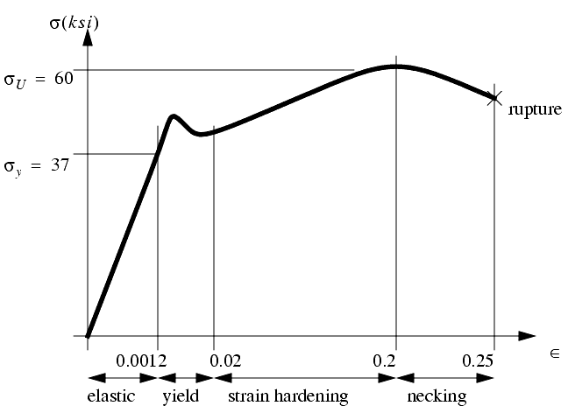
Stress/Strain Regions
Once the stress reaches the yield stress, it plastically deforms
σ_{y} is the yield stress
σ_{U} is the ultimate tensile stress
The final stress before rupture is called the fracture stress

Slide 16
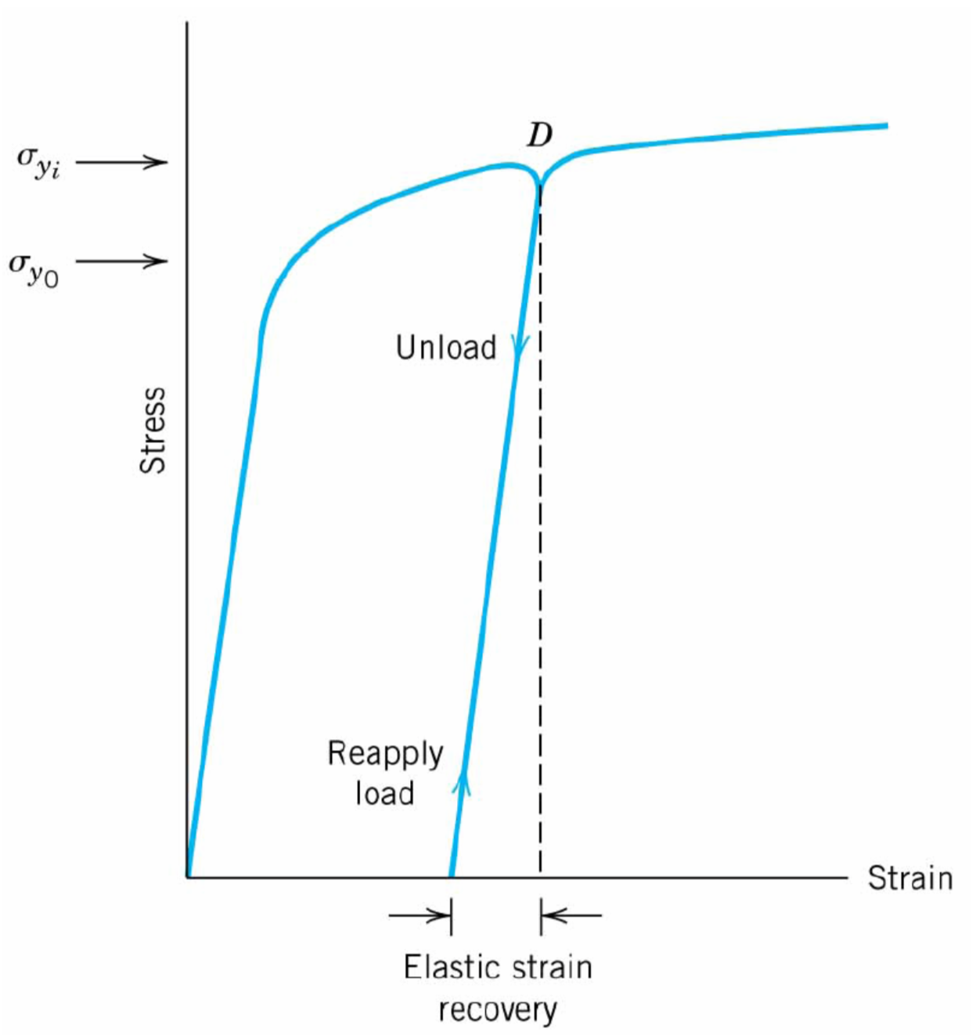
Permanent Strain
After plastic deformation, if you unload the sample, it still has the permanent strain
After unloading, the strain hardening has changed the material
Thus, if you reload, the yield strain is often higher than it was previously

Slide 17
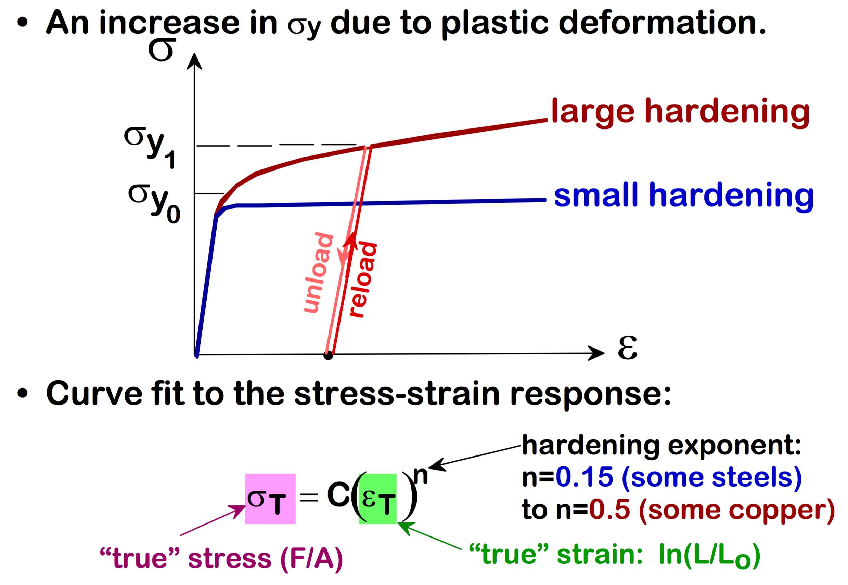
The hardening behavior changes for different materials

Slide 18
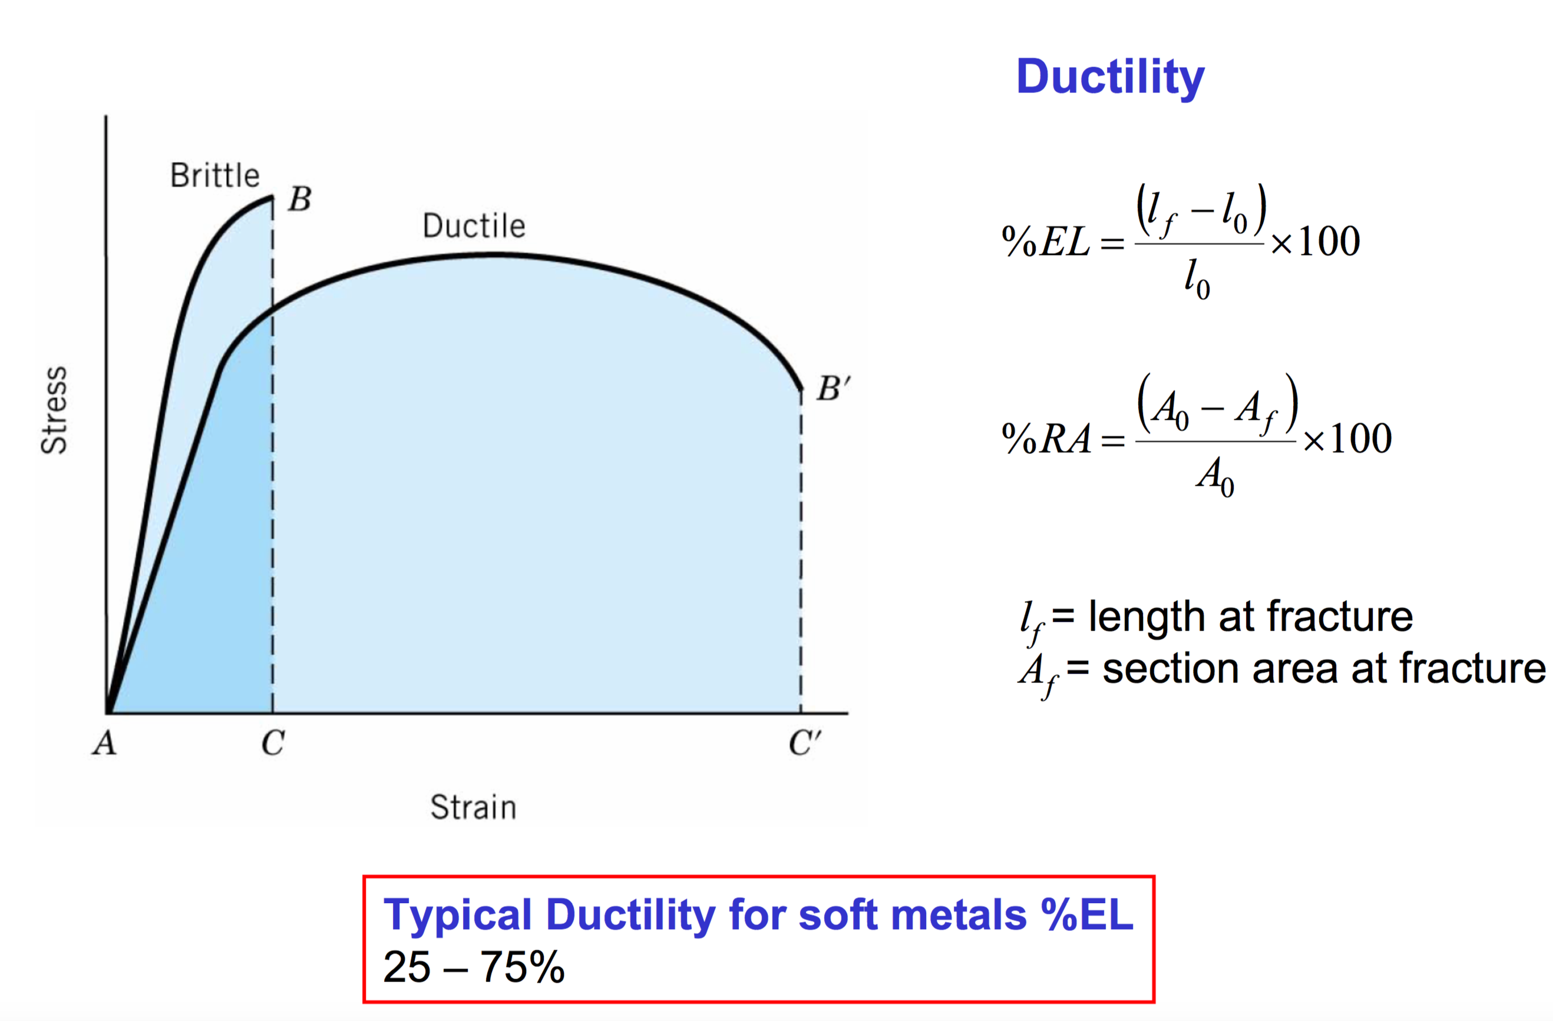
Ductile materials plastically deform significantly, brittle materials do not

Slide 19
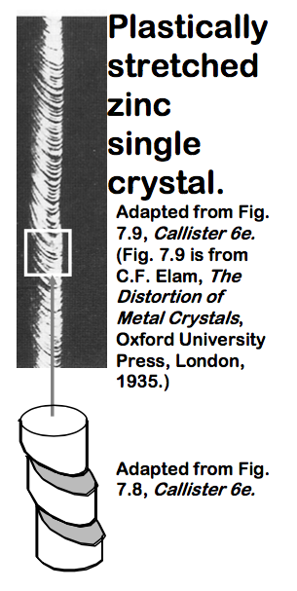
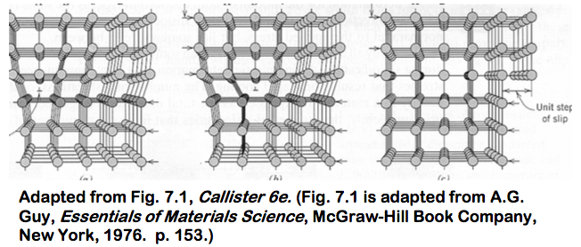
Dislocation motion
Plastic deformation occurs due to dislocation motion
A dislocation is a line defect
Edge and screw type
When it moves, only a small number of bonds are broken at a time

Slide 20
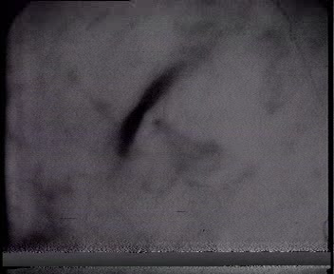
Dislocation are produced during deformation

Slide 21

Dislocation motion causes plastic deformation, dislocation pileup causes hardening

Slide 22
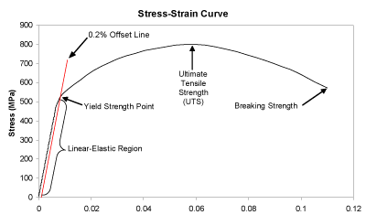
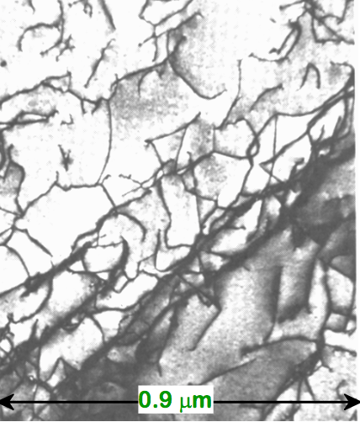
As the dislocation density increases, dislocations cannot move freely, raising the yield stress

Slide 23
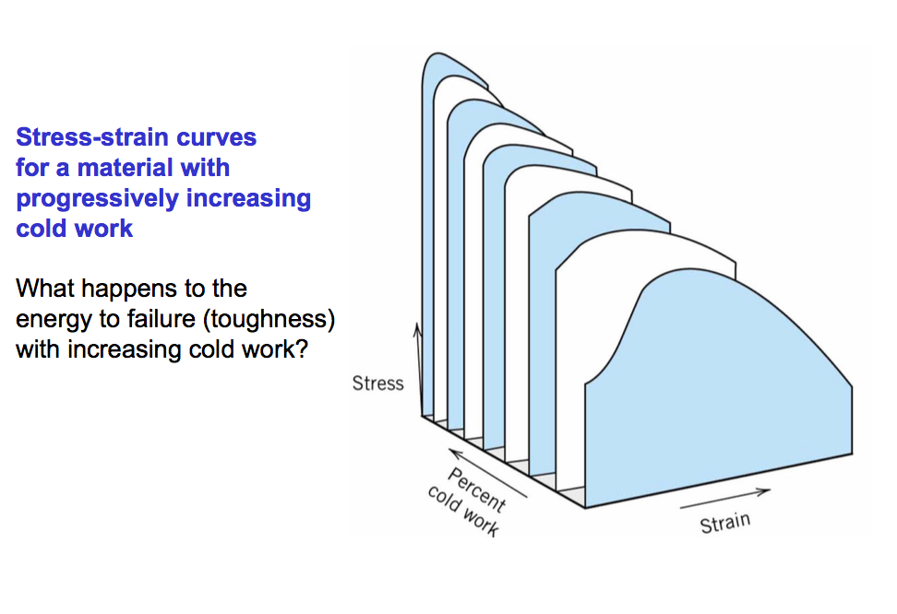
As the strength increases due to dislocation pile-up, the ductility decreases

Slide 24
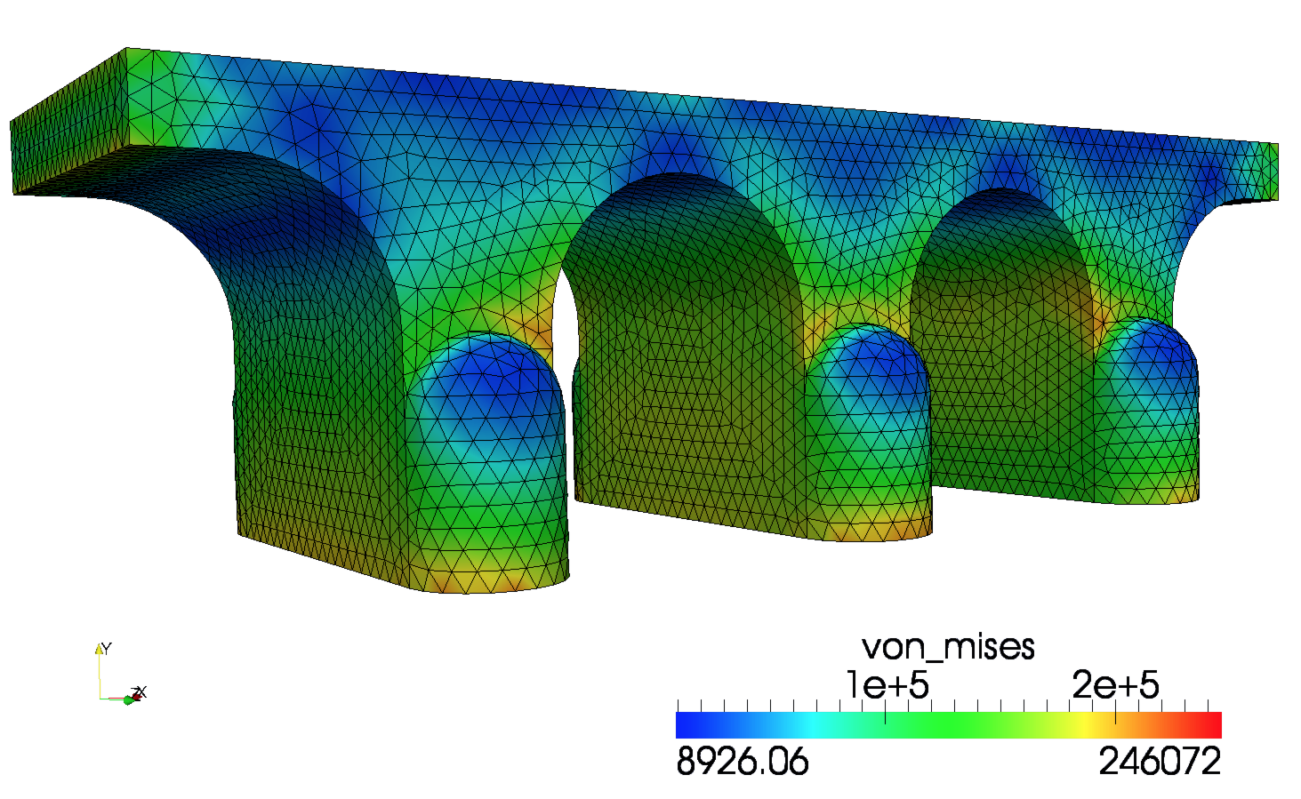
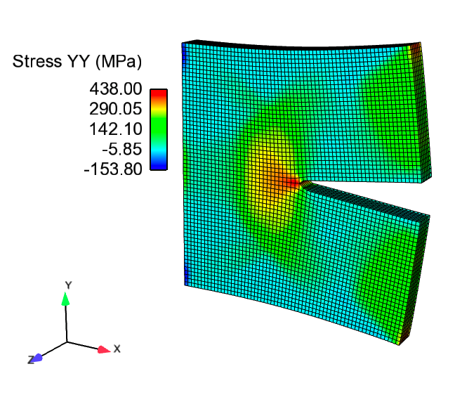
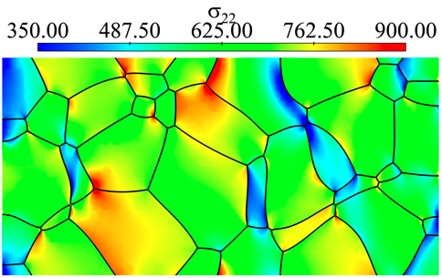
We need to determine the stress and strain throughout a body

Slide 25
Cauchy momentum equation
In this equation, u is the displacement vector, ρ is the density, σ is the stress, and g is the acceleration of gravity.
Often, we are determining the stress and strain in a static body. So the equation becomes:
Finally, we can simplify things more by making our first assumption: the impact of gravity is negligible

Slide 26
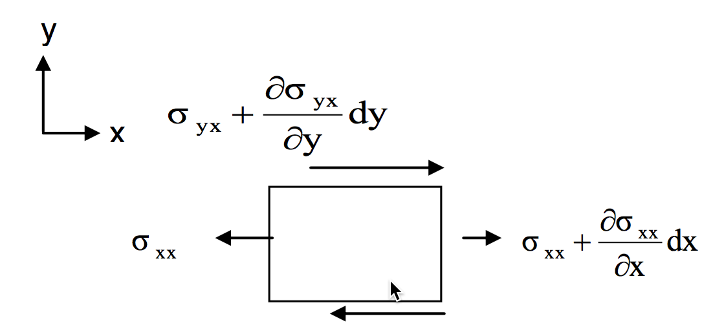
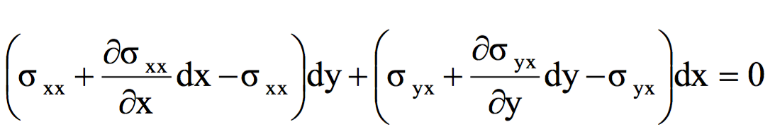
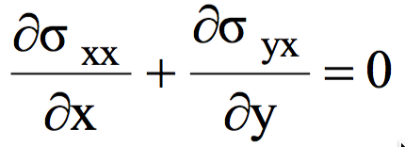
The stress divergence equation is really just a force balance

Slide 27
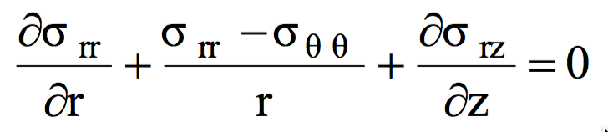
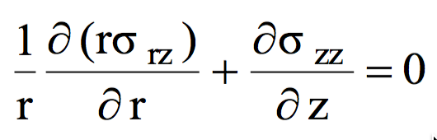
Consider an axisymmetric body
Assumption 1: We have a static body
Assumption 2: Gravity is negligible
Assumption 3: The problem is axisymmetric

Slide 28
Consider the material response of the axisymmetric body
We assume small strains, so the strain is defined as
We assume isotropic material response, so

Slide 29
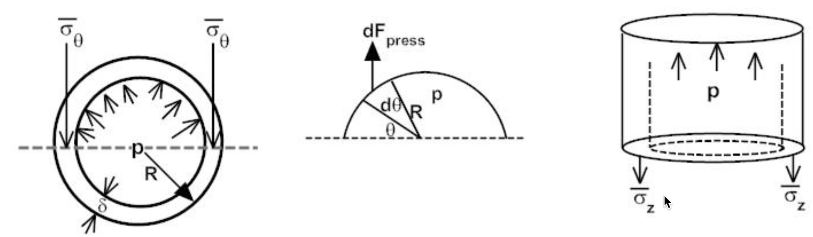
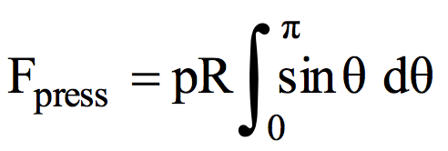
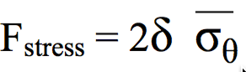
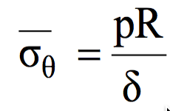
Solve for the stress throughout a pressurized cylinder (cladding tube) with thin walls
Because our cylinder has such thin walls (δ = thickness), we can simplify everything to simple force balance
First, we need the Force per unit length due to the pressure
Then we equate the forces and solve for the hoop stress
F_{stress}

Slide 30
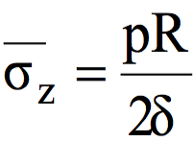
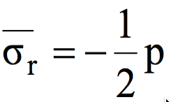
Find the other two stresses for a thin walled cylinder
To find the stress in the z-direction we do another force balance
Again, we equate the forces and solve for the stress
Last, the stress on the inside of the wall is –p and on the outside is zero, so the average
F_{top}
F_{wall}

Slide 31
Determine if a fuel rod will exceed its yield stress
A fuel rod has an initial pressure of 5 MPa that increases to 9 MPa during operation. Will it exceed its yield stress?
R = 0.55, δ = 0.06 cm, σ_{y} = 381 MPa
The largest stress will be the hoop stress
The hoop stress is P*(0.55/.06)
For 5 MPa, σθ = 45.8 Mpa
For 9 MPa, σθ = 82.5 Mpa
With these pressures, we don’t come even close to the yield stress of the cladding

Slide 32
Develop equations for the stress within a cylinder under pressure that has thicker walls
The cylinder as an inner radius R_{i} and an outer Radius R_{o}
We assume there is no shear stress, so σ_{rz} = 0
We will begin with the r equation
Now we need our constitutive law
We combine these equations to get

Slide 33
Develop equations for the stress within a cylinder under pressure that has thicker walls
We need one more relationship from the definition of the strain
From the previous slide, we have
If we combine these, we get
Again, from the previous slide
We end up with

Slide 34
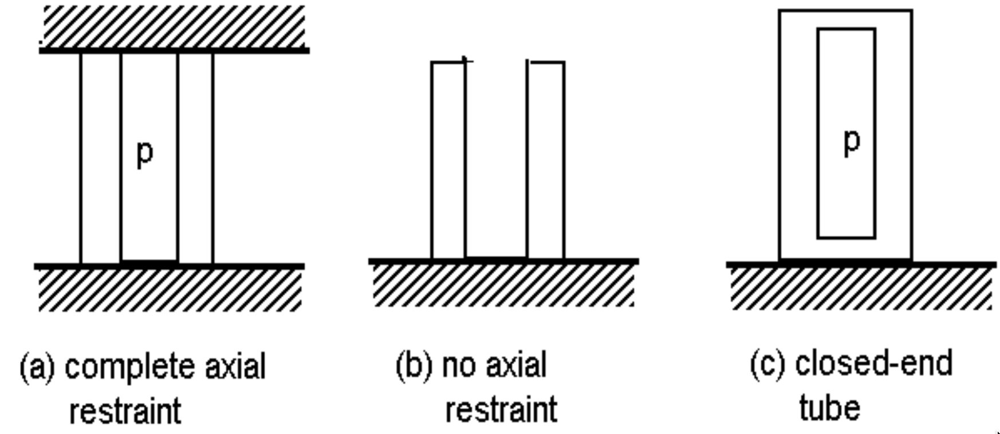
We now have an ODE so we can solve to get the stress
Our boundary conditions are σ_{rr}(R_{i}) = -p and σ_{rr}(R_{o}) = 0
After integrating twice, we get
From σ_{rr}, we can get σ_{θθ} from
From the end condition, we determine σ_{zz}
(a)
(b)
(c)

Slide 35
Stresses vary over the thickness of the cladding tube

Slide 36
Determine if a fuel rod will exceed its yield stress
A fuel rod has an initial pressure of 5 MPa that increases to 9 MPa during operation. Will it exceed its yield stress?
R_{i} = 0.52, R_{o} = 0.58 cm, σ_{y} = 381 MPa
Which stress is the largest?
σ_{θθ}
At what position r will the hoop stress be the largest?
r = R_{i} = 0.52 cm
What is the stress at p = 5 MPa?
σ_{θθ} = 5*((0.58/0.52)^2 + 1)/((0.58/0.52)^2 – 1) = 46.0 MPa
What is the stress at p = 9 Mpa?
σ_{θθ} = 5*((0.58/0.52)^2 + 1)/((0.58/0.52)^2 – 1) = 82.7 Mpa
Again, we don’t even get close to yielding

Slide 37
We’ve now solved this same problem assuming thin and thick walled cylinders

Slide 38
Summary
Solid mechanics predicts the deformation of a body from its applied load
The strain defines the deformation
The stress defines the material’s internal response to the strain
Materials can have recoverable and permanent deformation
Elastic deformation is recoverable and occurs due to the stretching of the atomic lattice
Plastic deformation is permanent and results form the breaking of bonds during dislocation (line defect) migration
We derived two analytical solutions for the stress in a pressurized cylinder
Thin walled cylinder
Any size wall

